Slide 1
HEXACO & The Dark Triad of Personality
Personality Psychology

Slide 2
HEXACO
Michael Ashton, of the Psychology Department at Brock University in St. Catherine’s, Ontario, Canada, and Kibeom Lee, of the Psychology Department at the University of Calgary, Alberta, Canada, have proposed a six-factor model of personality (2007, 2009).
Two of the factors—extraversion and conscientiousness—are similar to those found in the five-factor model; the other four differ in various degrees from the earlier work and are unique to this model of personality (Ashton & Lee, 2008; Shepherd & Belicki, 2008).
He named six factors or dimensions of personality as the HEXACO (an acronym derived from the factors).

Slide 4
HEXACO
The dimensions of this six-factor model can be assessed by two self-report inventories: the 100-item HEXACO Personality Inventory, Revised, or the 60-item HEXACO-60. Both have been shown to be valid and reliable tests (Ashton & Lee, 2009).
The factors have been documented in several different cultures including Dutch, French, German, Hungarian, Italian, Korean, Polish, Greek, Croatian, Turkish, and Filipino (Ashton et al., 2006; Ashton et al., 2004; DeRaad & Barelds, 2008).
In a study of adults in Italy, a high score on the HEXACO factor of conscientiousness was linked to the tendency to vote for right-wing political parties, whereas people who tended to vote for left-wing political parties scored higher in honesty, agreeableness, and openness (Chirumbolo & Leone, 2010).
Research with college students in New Zealand found that those low in openness to experience and emotionality scored high in right-wing authoritarianism and prejudice toward dissident groups (Sibley, Harding, Perry, Asbrock, & Duckitt, 2010).
A study of employed Americans found that those who scored high in honesty/humility received higher job performance ratings than those who scored low (Johnson, Rowatt, & Petrini, 2011).

Slide 5
HEXACO
Research in Egypt found that high scores on the honesty/humility factor correlated with stronger religious feelings but not with happiness (Aghababaei, 2012; Aghababaei & Arji, 2014).
Among college students in Portugal, the honesty/humility factor did correlate with happiness (Oliveira, 2013).
Adult delinquents in England and those convicted of crimes in Australia scored low on honesty/humility and high on Eysenck’s psychoticism dimension (Dunlop, Morrison, Loenig, & Silcox, 2012; Rollison, Hanoch, & Gummerum, 2013).

Slide 6
The Dark Triad of Personality
Delroy Paulhus and Kevin Williams, of the University of British Columbia, Vancouver, Canada, introduced a three-factor approach to understanding the darker side of personality, which includes the following traits (2002):
Narcissism: extreme selfishness, an inflated sense of one’s abilities and talents, and the constant need for admiration and attention.
Machiavellianism: the need to manipulate others, characterized by cunning, deceit and unscrupulous behaviors.
Psychopathy: callous, insensitive, egocentric, antisocial, takes advantage of other people, using great charm and often violence.

Slide 7
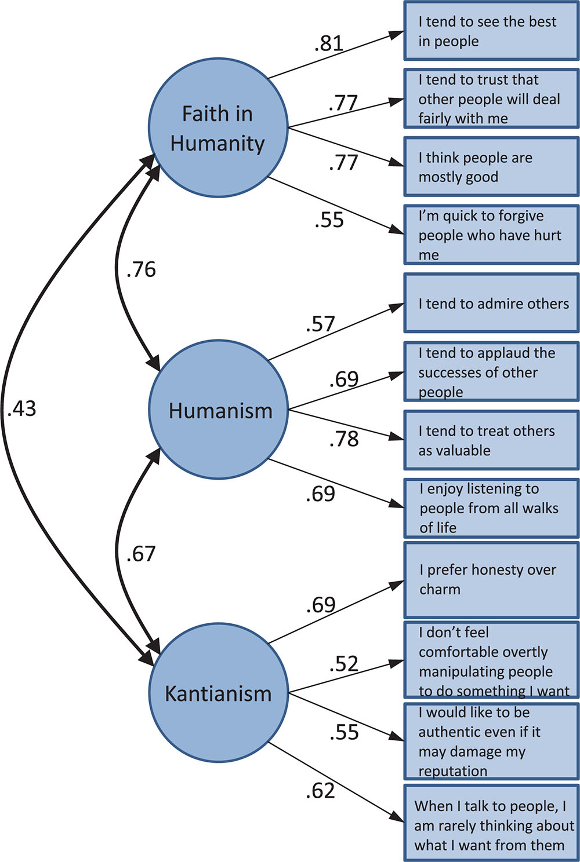
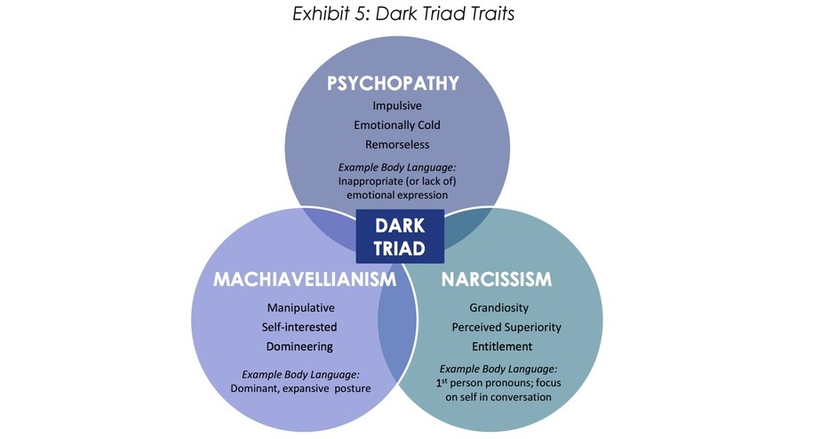

Slide 8
Behavioral Approach
Personality Psychology

Slide 9
Skinner’s Reinforcement
Skinner’s approach to behavior, simple in concept, is that behavior can be controlled by its consequences, that is, by what follows the behavior.
Skinner believed that an animal or a human could be trained to perform virtually any act and that the type of reinforcement that followed the behavior would be responsible for determining it.
This means that whoever controls the reinforcers has the power to control human behavior, in the same way an experimenter can control the behavior of a laboratory rat.
Skinner distinguished between two kinds of behavior: respondent behavior and operant behavior.
Respondent behavior involves a response made to or elicited by a specific stimulus.
A reflexive behavior such as a knee jerk is an example of respondent behavior. A stimulus is applied (a tap on the knee) and the response occurs (the leg jerks).
This behavior is unlearned.
It occurs automatically and involuntarily. We do not have to be trained or conditioned to make the appropriate response.

Slide 10
Skinner’s Reinforcement
Conditioning
At a higher level is respondent behavior that is learned. This learning, called conditioning, involves the substitution of one stimulus for another.
The concept originated in the work of the Russian physiologist Ivan Pavlov in the early 1900s.
Later, Pavlov’s ideas on conditioning were adopted by John B. Watson as the basic research method for behaviorism
Reinforcement
The act of strengthening a response by adding a reward, thus increasing the likelihood that the response will be repeated.
A conditioned response cannot be established in the absence of reinforcement. The act of reinforcing a response strengthens it and increases the likelihood that the response will be repeated.
Extinction
The process of eliminating a behavior by withholding reinforcement.
A great deal of research has demonstrated that the greater the reinforcement given during training, the more resistant the conditioned response will be to extinction (Shull & Grimes, 2006).

Slide 11
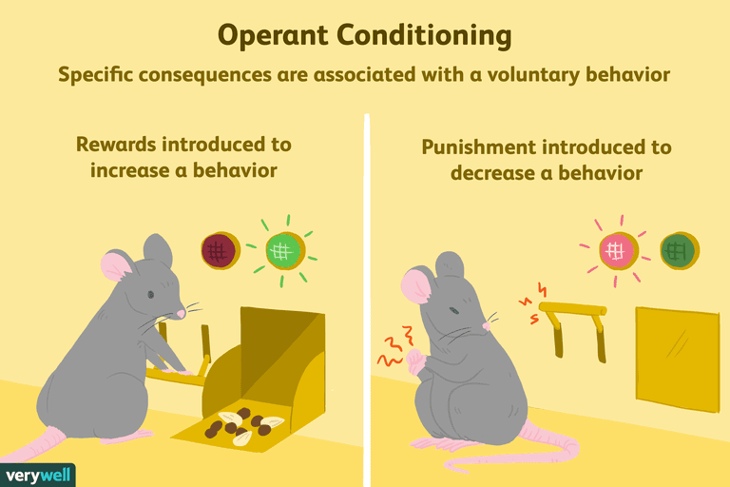
Skinner’s Operant Behavior
Behavior emitted spontaneously or voluntarily that operates on the environment to change it.
To Skinner, respondent behavior was less important than operant behavior.

Slide 12
Bandura’s Modelling
Bandura agreed with Skinner that behavior is learned, but with that point their similarity ends.
Bandura criticized Skinner’s emphasis on individual animal subjects rather than on human subjects interacting with one another.
Bandura’s approach is a social-learning theory that investigates behavior as it is formed and modified in a social context.
He argued that we cannot expect data from experiments that involve no social interaction to be relevant to the everyday, real world, because very few people live in social isolation.

Slide 13
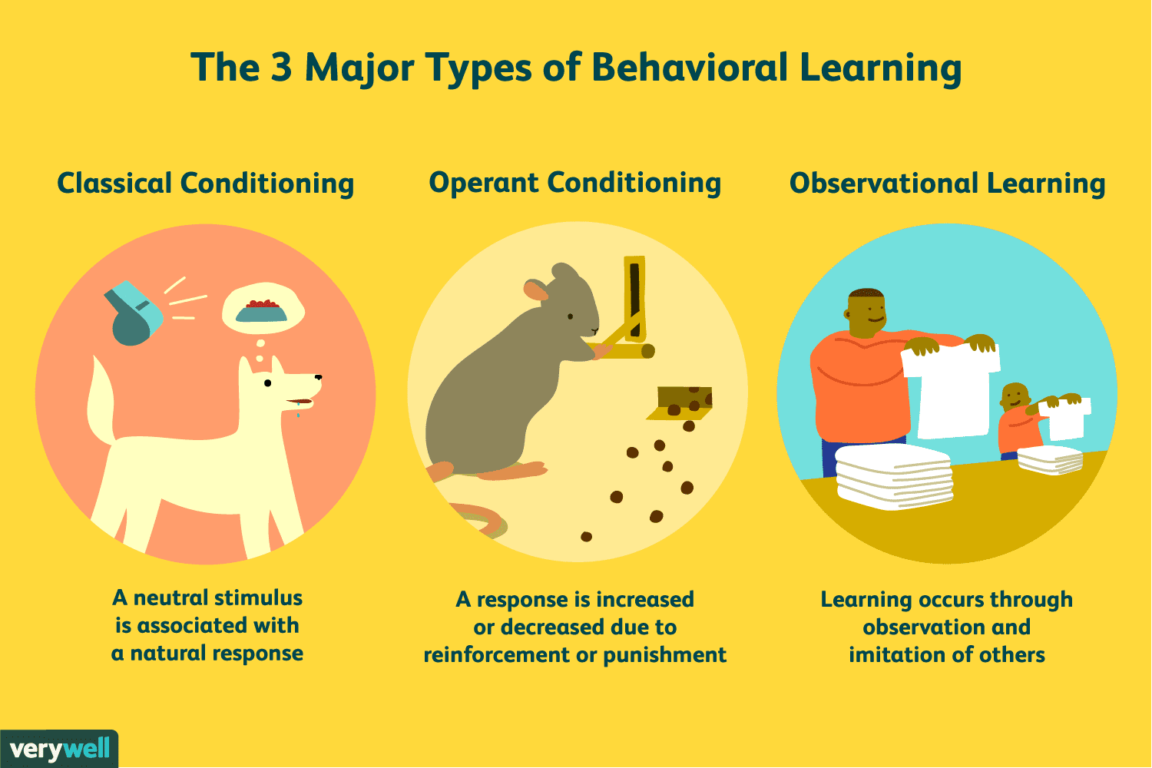
Modelling: The basis of observational learning
Bandura’s basic idea is that learning can occur through observation or example rather than solely by direct reinforcement.
Bandura did not deny the importance of direct reinforcement as a way to influence behavior, but he challenged the notion that behavior can be learned or changed only through direct reinforcement.
He argued that operant conditioning, in which trial-and-error behavior continues until the person happens upon the correct response, is an inefficient and potentially dangerous way to learn certain skills such as swimming or driving.

Slide 14
Disinhibition & Vicarious Experience
Disinhibition
The weakening of an inhibition or restraint through exposure to a model.
For example, people in a crowd may start a riot, breaking windows and shouting, exhibiting physical and verbal behaviors they would never perform when alone.
They are more likely to discard their inhibitions against aggressive behavior if they see other people around them doing so.
Vicarious Experience
Seeing other people perform successfully—strengthen self-efficacy, particularly if the people we observe are similar to us in their abilities.
In effect, we are saying, “If they can do it, so can I.”
In contrast, seeing others fail can lower self-efficacy: “If they can’t do it, neither can I.”
Therefore, effective models are vital in influencing our feelings of adequacy and competence.
These models also show us appropriate strategies for dealing with difficult situations.

Slide 15
Characteristics of the Model
Bandura and his associates (Bandura, 1977, 1986) investigated three factors found to influence modeling:
The characteristics of the models (similarity, age, sex, status, size & weight, behavior displayed by the models)
The characteristics of the observers (age, attributes → in self-confidence and self-esteem are much more likely to imitate a model’s behavior than are people high in self-confidence and self-esteem.)
The reward consequences associated with the behaviors

Slide 17
Self-Reinforcement & Self-Efficacy
Self-Reinforcement
Administering rewards or punishments to oneself for meeting, exceeding, or falling short of one’s own expectations or standards.
Self-reinforcement is as important as reinforcement administered by others, particularly for older children and adults.
Self-Efficacy
Our feeling of adequacy, efficiency, and competence in coping with life.
People low in self-efficacy feel helpless, unable to exercise control over life events. They believe any effort they make is futile.
Low self-efficacy can destroy motivation, lower aspirations, interfere with cognitive abilities, and adversely affect physical health.
People high in self-efficacy believe they can deal effectively with events and situations.
High self-efficacy reduces fear of failure, raises aspirations, and improves problem solving and analytical thinking abilities.

